Slide 1
CSCI 6234 Assignment 2
Group 10:
Mingqian Liu
Zhibo Sheng
Kai Wang
Junwen Wen

Slide 2
Actors
Users: include participants and moderators
Participants: normal users
Moderators: users with extra privileges
Movie API/Server: provide movie service

Slide 3
Use Cases
1. Sign in/up: sign in/up to system
Preconditions: a user has an account or want to have one
Postconditions: user logged in or registered successfully
Steps: 1. Users click the “sign in/up” button. 2. Users fill in the ID and password then click “ok” to sign in/up. 3. System displays sign in/up successful
2. Sign out: sign out to system
Preconditions: a user has signed in the system
Postconditions: system displays signed out successful
Steps: 1. Users click on the “sign out” button. 2. System displays sign out successful
3. Create watcher group: moderator creates watcher groups
Preconditions: a user has logged in as a moderator
Postconditions: a watching group is created
Steps: 1. Moderator clicks the “create watecher group” button. 2. System shows the new group

Slide 4
Use Cases
4. Invite to group: moderator invites users to watcher group
Preconditions: a user has logged in as a moderator; the watcher group is created; the invited users existed
Postconditions: new users joined in the watcher group
Steps: 1. Moderator goes to a existed group. 2. click the “invite” button. 3. enter user’s ID then clicks on “submit” button. 4. System displays “invitation is sent”
5. Join a watcher group: users join a watcher group
Preconditions:users have logged in; the watcher group existed
Postconditions: the user can access to the group
Steps: 1. Users click on “subscribe” button. 2. Enter the group ID then press “ok”. 3. System shows subscribe successful.
6. Unsubscribe watcher group: users unsubscribe watcher group
Preconditions: users have logged in; the watcher group existed
Postconditions: users cannot access to the group
Steps: 1. Users goes to the group page. 2. Users click the “unsubscribe” button. 3. System shows unsubscribe successful

Slide 5
Use Cases
7. Add movies: moderator populates a list movies to a watcher group
Preconditions: a user has logged in as a moderator; the watcher group existed; movie lists existed
Postconditions: a new movie list shows in the watcher group
Steps: 1. Moderator goes to a group. 2. Moderator click “upload movies ” 3. Select movies then press ok. 4. System shows a updated movie lists in group
8. Pull movie list: moderator pulls movie lists from API/server
Preconditions: a user has logged in as a moderator; known APIs/servers
Postconditions: the movie lists added to system
Steps: 1. Moderator sends a http request to API. 2. APIs process the request. 3. System shows the movie lists

Slide 6
Use Cases
9. Search and browse movies: group members search and browse movies
Preconditions: users have logged in; the watcher group existed; movie lists existed; search function is existed
Postconditions: users get the results of searching and all the movies to browse
Steps: 1. Users go to a group. 2. Click “search” button. 3. Enter the movie name then press “ok”. 4.system displays the results
10. Watch the trailer: group members watch the trailers(populated by the moderator)
Preconditions: users have logged in; the watcher group existed; moderator has populated movies
Postconditions: a trailer is playing
Steps: 1. Users go to the group. 2. Search for a selected movie then submit. 3. Click on the “trailer” that next to the movie. 4.system displays the trailer

Slide 7
Use Cases
11. Access to movie reviews: group members access to movie reviews(populated by the moderator)
Preconditions: users have logged in; the watcher group existed; moderator has populated movies; movie reviews existed
Postconditions: movie reviews are showing
Steps: 1. Users go to the group. 2. Search for a selected movie then submit. 3. Click on the “reviews” next to the movie. 4. System shows the movie reviews.
12. Create a movie watching event: moderator creates a movie watching event
Preconditions: a user has logged in as a moderator
Postconditions: a new movie event added to system
Steps: 1. Moderator click the “create movie events”. 2. Set the date. 3. System displays the successful feedback

Slide 8
Use Cases
13. Open and close a voting: moderators open and close a voting to movie events
Preconditions: a user has logged in as a moderator; a voting exists before close it; movie events existed
Postconditions: a movie event can be voted; the voting to a movie event is closed
Steps: 1.moderator goes into the event. 2.click “open” or “close” a voting. 3. System shows a new voting or shut down a voting
14. Notified by events and voting: group member are notified new events and new voting
Preconditions: users have logged in; the watcher group existed; new event created; voting is open
Postconditions: group members knew the new event and new voting
Steps: 1.moderators have the “notify group members”box checked when they publish events and votings. 2. System sends notification email to group members.

Slide 9
Use Cases
15. Cast votes: group members cast votes for movies in movie events
Preconditions:users have logged in; the watcher group existed; the moderator created the events; the voting is open
Postconditions: group members their votes
Steps: 1. Group members click on the “voting”. 2. Choose a movie name then submit. 3. System displays vote successful info.
16. Check histories: group members check histories of movie events, votes, and winners
Preconditions: users have logged in; the watcher group existed; the moderator created the events; the voting is closed; the winners existed
Postconditions: the histories of movie events, votes, and winners are showing
Steps: 1. Group members click on “history”. 2. Choose movie events, votes, or winners. 3. System displays the results

Slide 10
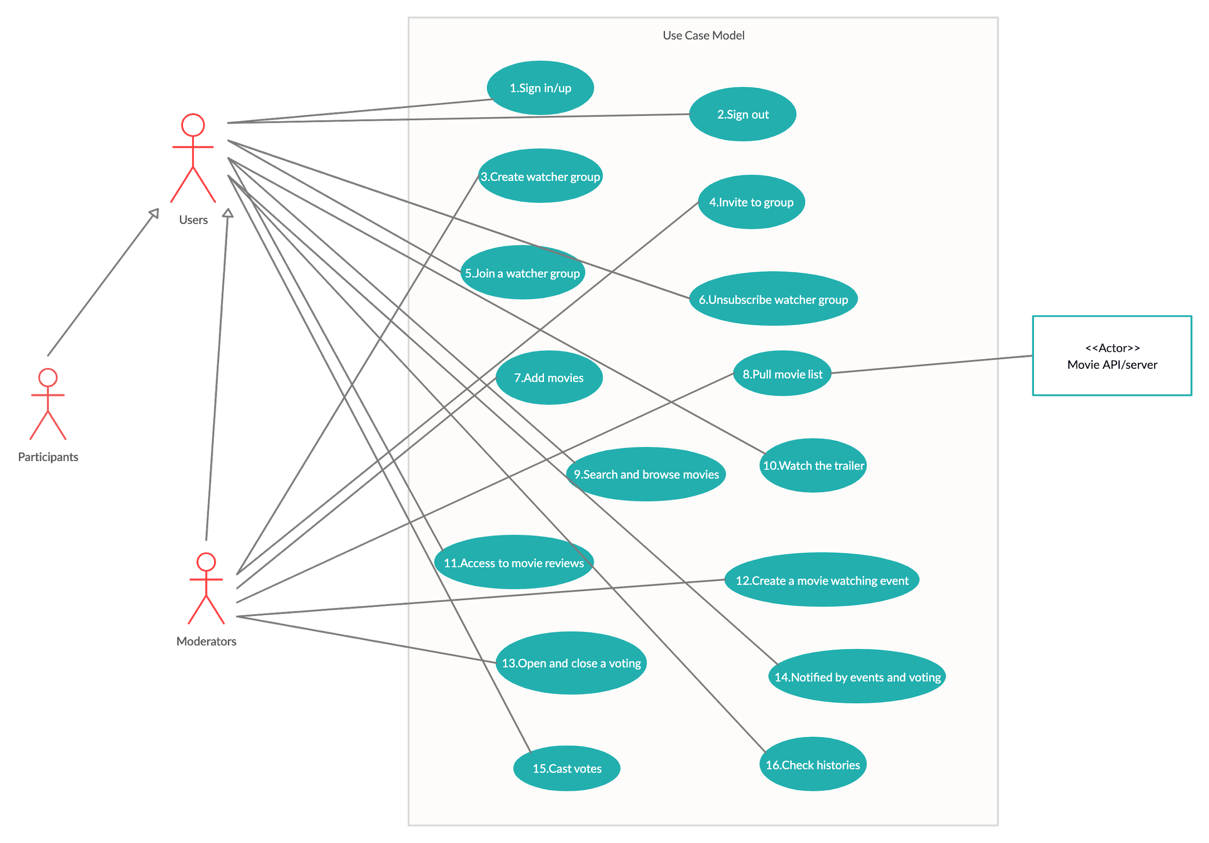
Use Case Diagram

